Slide 1
DECISION-BASED ADVERSARIAL ATTACKS: RELIABLE ATTACKS AGAINST BLACK-BOX MACHINE LEARNING MODELS
ABHISHEK JAIN
AJINKYA SHEKHAR MORE

Slide 2
Background and research problem studied
High performance Machine Learning Algorithms are susceptible to minimal changes of their inputs (Adversarial perturbations on VGG-19, like change Tiger cat to bus).
Existing Adversarial attacks are :- Gradient Based (Defense : Mask Gradients) Score Based (Defense : Add dropouts or Plateau) Transfer Based(Defense : Training data on adversarial examples)
Either attacks are weak or model is robust, so this motivates us to explore decision-based attacks. (More discovery to make reliable DNNs)
Boundary attack is an example of inducing minimal decision-based perturbations to the model (targeted or untargeted).
Advantages are simple, flexible, less information about model needed, protection from standard defenses, hence scalable to complex DNNs.

Slide 3
Approach Applied and Main Contributions
Boundary attack is a phenomenon where we try to make any adversarial image look closer to original image by using progressively smaller orthogonal perturbations.
It can fit into any criteria, such as outside computer vision
Evaluate boundary attacks in two different settings: 1. Untargeted setting : flip boundary attack to any label 2. Targeted setting : flip boundary attack to particular label Two Hyperparameters : Delta and Epsilon. The attack is converged when epsilon is zero.
Testing on models from Clarifi.ai and real-world datasets such as ImageNet and MNIST confirms the effectiveness of the proposed boundary attack method. They are considered difficult to attack
The Foolbox framework includes implementations of various attacks like FGSM, Deepfool, and Calini and Wagner. They compared boundary attacks with these attacks.

Slide 4
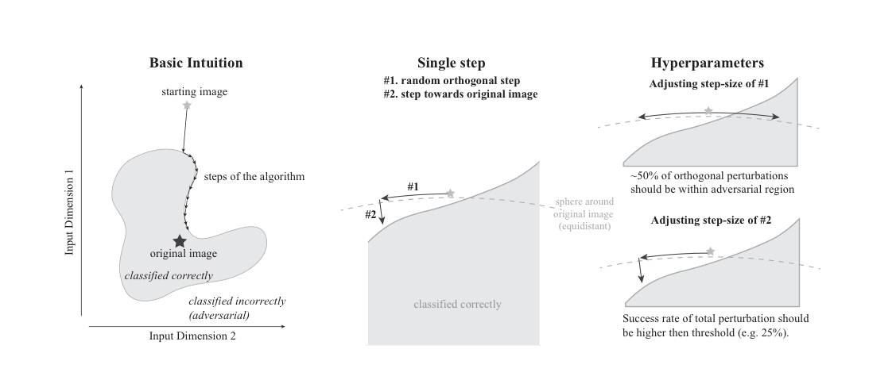
Hyperparameter Tuning

Slide 5
Approach Applied and Main Contributions
Despite its simplicity, the boundary attack method proves competitive with gradient-based attacks through targeted and untargeted strategies in untargeted attacks.
While boundary attack might require more passes and is expensive to run, but for imperceptible perturbations, few passes are required.
Concerns are raised about the efficacy of defensive distillation methods, which rely on changing gradients for cross-entropy loss. FGSM failed after performing this while the boundary attack is able to break defenses of gradient masking.
In a targeted attack, boundary attacks proved to be effective.
Suggestions for future improvements include enhancing the proposal distribution function.

Slide 6
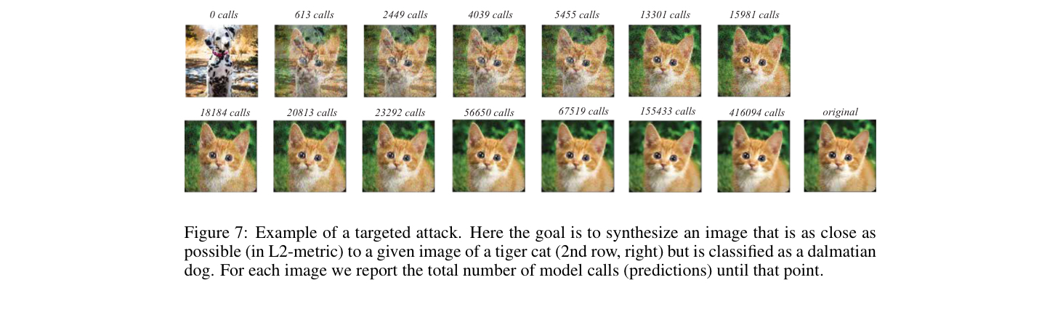
Example of a targeted attack

Slide 7
Re-implementation of the work (such as video demo)
https://colab.research.google.com/drive/1efNAkNL2S-BuTDXaKeJsPh8sCfdqc0ke#scrollTo=iNziF0QM4oDf
https://colab.research.google.com/drive/1weSRGrVXFdHLK8LQEZKdOoHm-Be7UCPl?usp=sharing
Video link :-

Slide 8
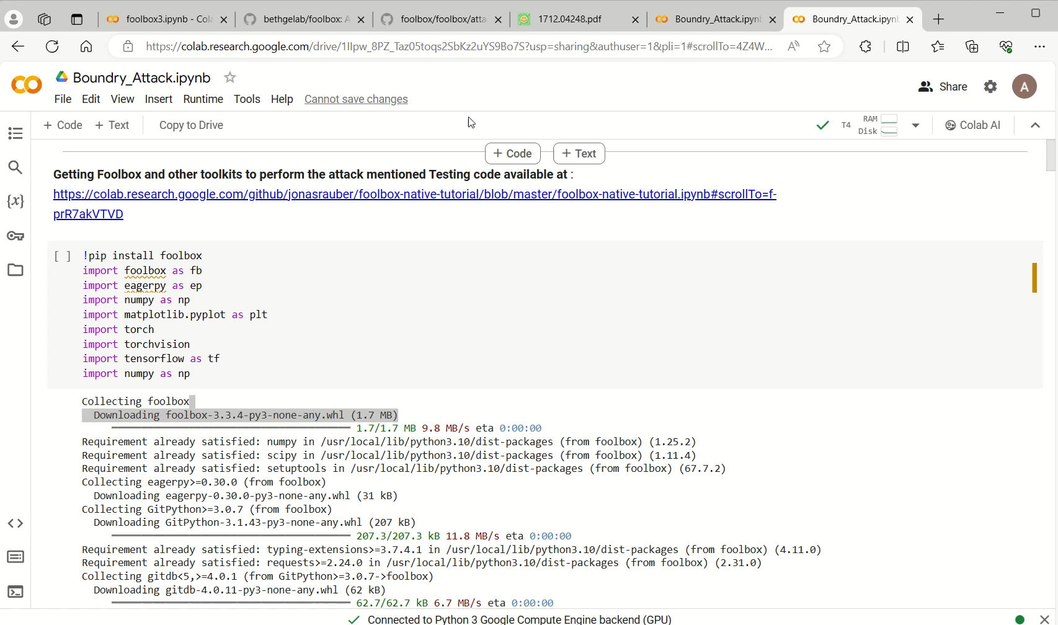
Enhancement beyond the work (such as video demo)
https://colab.research.google.com/drive/1IIpw_8PZ_Taz05toqs2SbKz2uYS9Bo7S?usp=sharing
Video Link :-

Slide 9
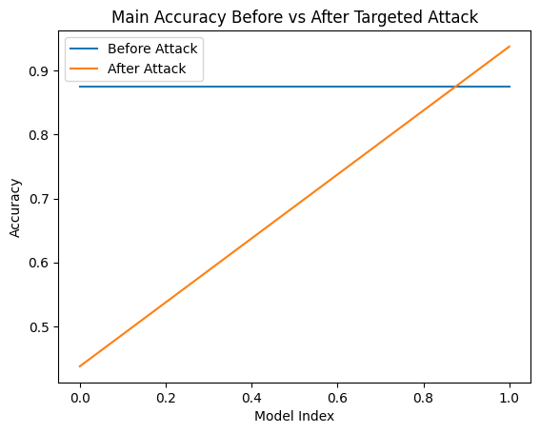
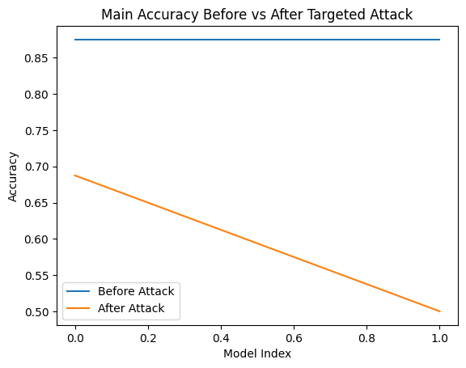
RESULT

Slide 10
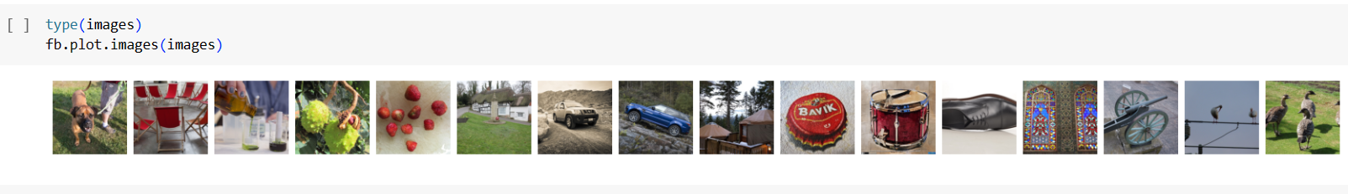
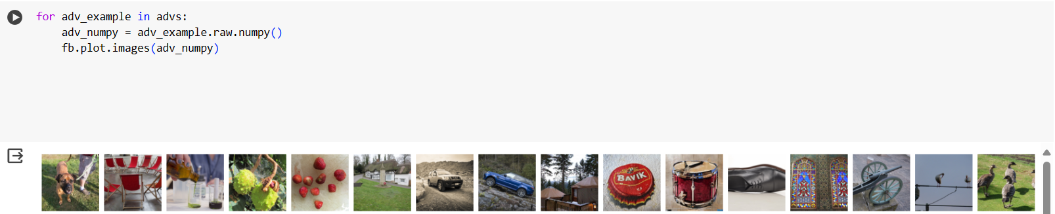
RESULT

Slide 11
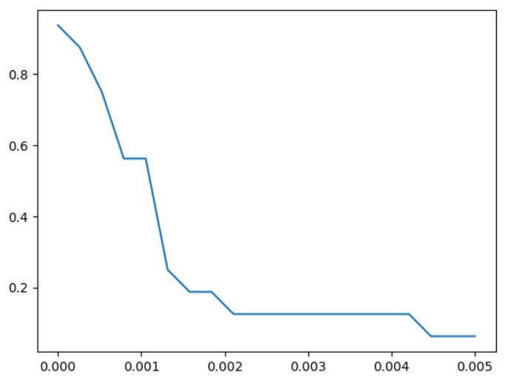
RESULT

Slide 12
Learnings
Here, most neglected, Decision-based attacks are emphasized for real-world applications like autonomous vehicles, where observation is limited. We need robustness for such serious applications.
Attacks in this Decision-based attacks class is highly relevant wherever it does not rely on substitute models, it is robust from deceptions and there is no data about model available.
We explored one of the categories of decision-based attacks such as Boundary Attack which proved to be reliable and effective.
Boundary attack was dependent on the simple fact that a gaussian distribution can serve as an effective proposal perturbation which is a vulnerability to the existing DNN models.
Sometimes simple and perceivable engineering solutions are effective rather than thinking of the most complex solutions.

Slide 13
END
THANK YOU!

